Slide 1
Analysis of the Concrete Slump Test data set
Leonardo Espin
July 3, 2019

Slide 2
Exploratory data analysis
The data set contains seven input variables, measured as weight in kilograms per cubic meter, and three output variables. Of the three output variables we are interested only in compressive strength (CS, measured in Mpa)
There are 103 measurements in the data set, and all the variables are continuous

Slide 3
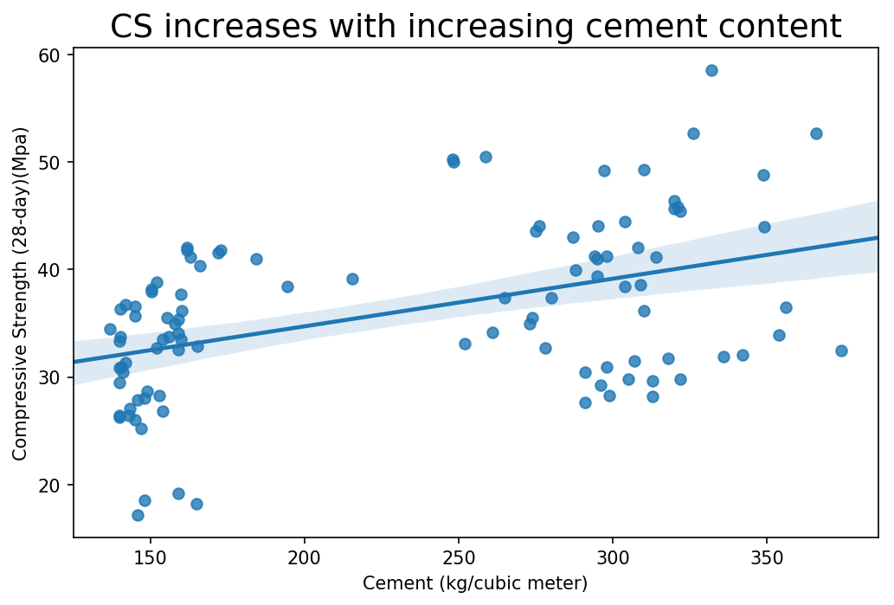
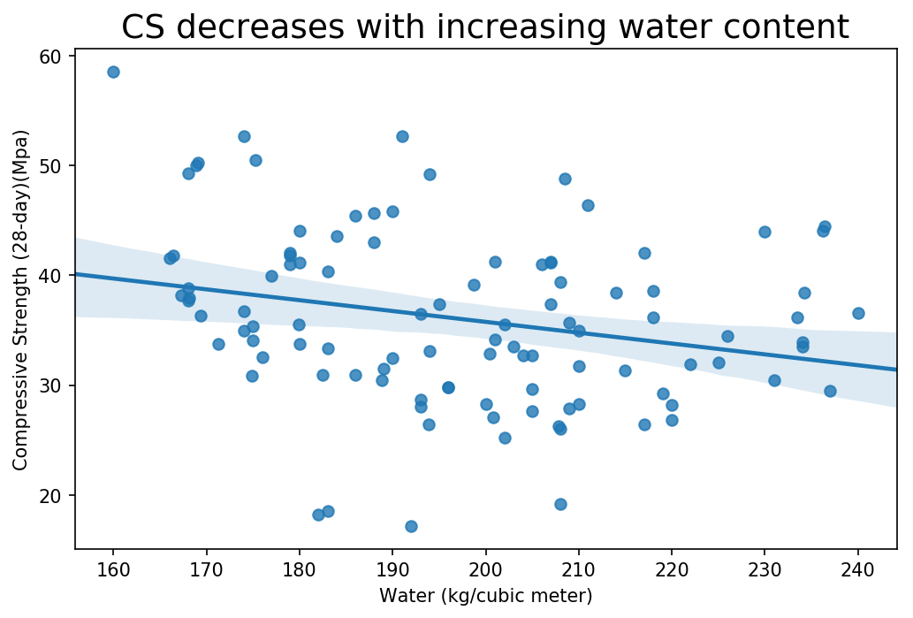
Predictive power of the variables
Two of the variables with most predictive power are cement content and water content. How they affect CS can be seen in the scatter plots above

Slide 4
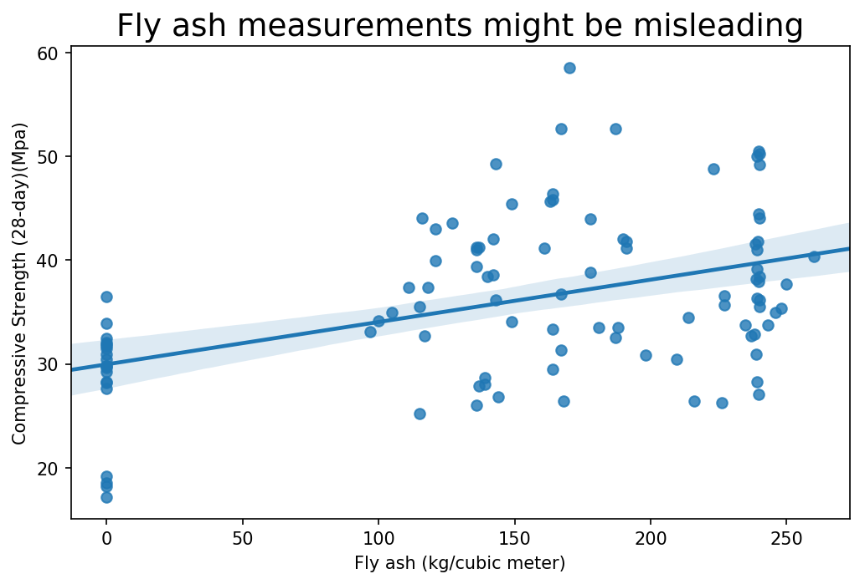
Predictive power of the variables
At a superficial level fly ash seems to indicate a clear trend. Close inspection of this scatter plot shows that there is a gap, with no measurements between 0 kg and 100kg. This is suspicious

Slide 5
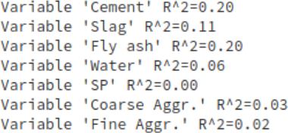

Predictive power of the variables
R^2 coefficient for all variables
R^2 after removing zeroes
Calculating the coefficient of determination for the individual regressions of all variables reveals those with most predictive power.
After removing the zero measurements for fly ash, its predictive power drops to zero

Slide 6
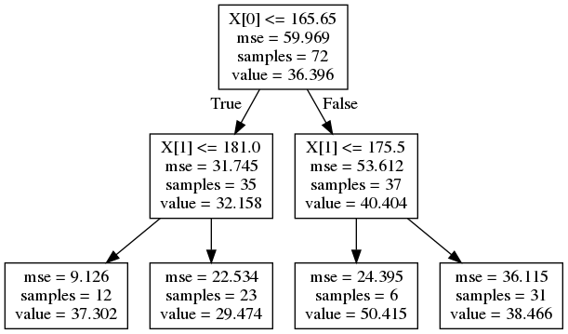
A decision tree model built with two variables
This tree was built with the variables cement and water content (x[0] and x[1])
Comparing predictions of this tree against measurements in an unseen portion of the data gives an error of 6.48 Mpa, which is reasonable given that the mean of the CS measurements of 36 .04 Mpa

Slide 7
A random forest model built with 23 trees
By comparing random forest models using the feature_selection python module I found that the best features to include in the model are cement, fly ash and water content, coinciding with my EDA analysis
As mentioned, the fly ash measurements might be misleading, and it would be worthwhile to investigate how this measurements were made
A final random forest model with 23 models gave an error of 2.97 Mpa (using the same comparison procedure) which is pretty good

Slide 8
Final observations
Decision trees and random forest models do not require variable rescaling, which is why an scaling analysis was not necessary in this task
Fy ash measurements might have some problems. Rather than using more complex models, it might be more beneficial to find out how this variable was measured
Concrete is used for its resilience and durability. The analysis and models like the ones I have done in this task could be useful for learning better ways to, for example, mix concrete or select proportions for the components of concrete used in construction.

